Slide 1
Electronics
Resistance
R
LabRat Scientific
© 2018

Slide 2
Resistors
Resistors regulate how much current will flow through an electrical circuit
The ideal wire will have no resistance
Resistors convert the “excess” electrical power to heat, which is radiated off
Toasters used strips of high resistance metal so they get glowing hot when current is passed through them

Slide 3
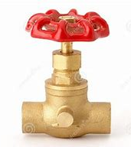
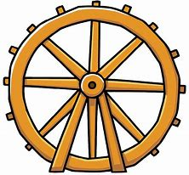
Water Valve / Electrical Resistor Analogy
The water valve is used to regulate how much water flows through the pipe. A resistor does essentially the same thing for electrical current.
The water tanks is similar to a battery.
The water’s flow rate dictates how fast the water wheel will spin and how much work it can do. This is similar to an electric motor.

Slide 4
Relative Resistance of Materials
Very High Resistance
Air
Wood
Rock
Plastic
Distilled Water
Paper
Moderate Resistance
Salt Water
Very Low Resistance
Copper
Gold
Aluminum
Steel

Slide 5
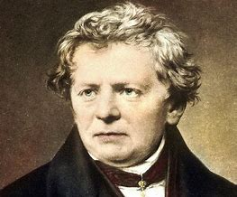
Unit of Resistance
The unit of resistance is known as the OHM
The Ohm is named in honor of the German physicist Georg Simon Ohm who conducted basic experiments to characterize electrical resistance in the early 1800’s
Georg Ohm also developed Ohm’s Law:
Voltage (V) = Current (I) x Resistance (R)
Georg Ohm (1787 – 1854)

Slide 6
Methods for Altering Resistance
Making a wire larger in diameter will reduce resistance
Example: NASA uses copper cables to provide power to rockets while they are on the launch pad. If long distances are involved, a power supply set at 28 volts in the blockhouse may only result in 25 volts out at the rocket. To rectify this, wires are “doubled up” in order to effectively increase the diameter of a wire. This also has the effect of “parallel” resistance, which reduces the total resistance (see later slides).
Making a wire longer will increase resistance
The material that a wire is made of affects resistance
Gold is often used in connectors that need to have very low resistance

Slide 7
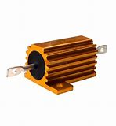
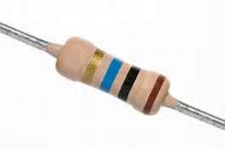
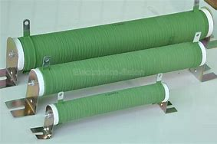
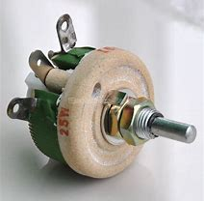
Resistors come in many shapes and sizes

Slide 8
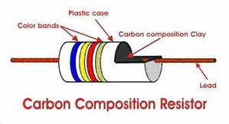
Typical Configuration of a Resistor found in a Circuit

Slide 9
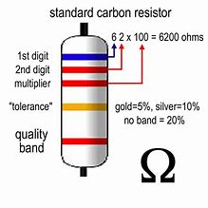
Resistor Color Coding
Band Color 1st Digit 2nd Digit Multiplier
Black 0 0 x 1
Brown 1 1 x 10
Red 2 2 x 100
Orange 3 3 x 1K
Yellow 4 4 x 10K
Green 5 5 x 100K
Blue 6 6 x 1M
Purple 7 7
Silver 8 8
White 9 9
Small resistors have colored bands around them. These bands identify the resistance of the resistor. The first two bands identify the numerical value of the resistor and the third band identifies the multiplier.

Slide 10
Connecting Resistors Together
While there is a limited number of specific resistors, they can be connected in various configurations to create the resistance that is required for the electrical circuit.
Series Connections:
Parallel Connections:
R1
R1
R2
R2
Calculating Total Resistance in Series Resistors:
R_{t} = R₁ + R₂ + R_{n}
Calculating Total Resistance in Parallel Resistors:
1 1 1 1
----- = ------ + ------- + ------
R_{t} R₁ R₂ R_{n}

Slide 11
Calculating Total Resistance – Series Example
R1
R2
R1 = 1,000 Ohms
R2 = 3,000 Ohms
R_{Total} = 1,000 Ohms + 3,000 Ohms = 4,000 Ohms

Slide 12
Calculating Total Resistance – Parallel Example
R1
R1 = 1,000 Ohms
R2
R2 = 3,000 Ohms
1 1 1 1 1 3 1
----- = ------ + ------ = --------------- + -------------- = --------------- + --------------
R_{t} R₁ R₂ 1,000 Ohm 3,000 Ohm 3,000 Ohm 3,000 Ohm
1 4
----- = --------------- = 0.00133 But we need to invert to get R_{t} = 752 Ohms
R_{t} 3,000 Ohm

Slide 13
Comparing the Results
R_{t} = 3,000 Ohms
You can see that two resistors connected in two different ways can result in vastly different total resistant values.
1000 Ohm
3000 Ohm
1000 Ohm
R_{t} = 752 Ohms
3000 Ohm
There is no limit to how many resistors that can be connected in series or parallel. In many cases, resistors can be combined in parallel and series…

Slide 14
Measuring Resistance – The Multimeter
R
M
The probes of the multimeter must be positioned “across” the device being measured.
The polarity of the probes is not important
You must set the meter to OHMS (or resistance)

Slide 15
Variable Resistors
Some resistors have variable resistance that can be adjusted. These are known as potentiometers. Potentiometers can be used to adjust volume on a stereo, or adjust the heat setting on a toaster.
Some resistance between 0 and 1,000 Ohms depending on the position of the “wiper”
0 Ohms
1,000 Ohms
(Or whatever…)
There are circular potentiometers (turn a dial) and linear potentiometers (slide a slider)

Slide 16
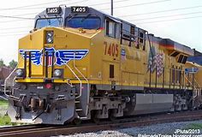
Resistors in Railroading
The dynamic breaking resistors are located towards the back of the locomotive
Modern railroad locomotives utilize giant resistor banks as part of their dynamic breaking systems. Dynamic breaking is a system that uses the electric motors that drive the wheels of the locomotive in reverse, making them powerful electrical generators. As the drive motors generate electricity during the breaking process they create significant resistance to the wheel rotation. The electricity that is generated must be dissipated, and this is done using the giant resistor bank. The resistors convert the electricity to heat that must then be ejected from the locomotive. This is done using large fans located on the roof of the locomotive.

Slide 17
Questions ?

